Slide 1
Improving the way we do things
Safety Climate Tool Safety Briefing/Tool Box Talk
Notes:
Guidance notes
This is a suggested format for a briefing session to tell your workforce why their organisation might want them to complete the Safety Climate Survey. You may wish to adapt the slides according to what’s happening within your own organisation.
The guidance notes give additional advice to help you deliver the talk and to answer any questions you might get asked.
The presentation should take no longer than 15 minutes.
Top tips for presenters
Just be yourself.
If you vary the tone of your voice, people are more likely to listen to what you have to say.
It’s easy to rush if you’re nervous, so try to slow down.
Keep it positive – this is something new. It’s about working together to find solutions so that health and safety is a natural part of the way we work.
Know your audience – if your presentation isn’t in their first language you may need to think carefully about how to get these messages across.
Presentation notes
This talk is to tell you about a survey we’re going to ask you complete in the next couple of [days/weeks]. We want to improve our approach to health and safety and we can only do that with your help.

Slide 2
The way we keep ourselves safe
What you think
What we do
Notes:
Guidance notes
‘What you think’ is another way to describe the safety climate and ‘What we do’ is another way to describe safety culture.
Don’t worry that you have to be an expert; the presentation notes give you everything you need to know. However, if you’d feel more comfortable knowing more background information about the theory there’s a short YouTube video clip at:
http://www.hsl.gov.uk/products/safety-climate-tool/what-is-safety-culture
Presentation notes
Culture is what makes one organisation different from another. Every organisational culture is made up of different sub-cultures, or cultures within cultures, and I want to talk about our safety culture.
The way we do things around here, or the way we keep ourselves safe, is one way of describing the safety culture in this organisation.
Our culture determines what priority we give to health and safety; its rules; the way jobs are done; the way people act and behave; the types of machinery and equipment they have in place; what targets they have. These all come together as what we do. It’s just the way things are done around here.
However, we all know that sometimes things change. Rules get broken, people may not act or behave the way they should; equipment or machinery might fail or might not be right for the work. Corners get cut. Often it’s only when an accident or near-miss happens that we know something isn’t quite right; but for some people that will be too late.
We don’t want you to get hurt, or worse, just from doing your job. Like the iceberg here, there will be a lot of things that our conventional way of gathering information can’t tell us. There may be things you think we could improve, but for whatever reason you may not feel you can tell us. We want to change things, but we need to see the big picture first.
We can’t see the big picture unless we find out what you think is going on beneath the surface about the way we manage health and safety here.

Slide 3
You know where the gaps are -
We need your help to find them.
Notes:
Presentation notes
We need your help if we’re going to make further improvements to the safety culture in this organisation. We need to know what you think is working, and where we need to do things differently.
We‘ve put a great deal of effort into making this a safe and healthy place to work in, but we recognise there are gaps in our knowledge that you can help us fill in.

Slide 4
Our plan
To run the Safety Climate Survey to find out how we can work together to make this a safer place to work.
Organisations that understand their safety climate have fewer accidents and near- misses.
Notes:
Presentation notes
The Health and Safety Executive has developed a Safety Climate Survey that organisations use to understand what the safety culture is like in their organisation so they can make improvements.
Health and safety is everyone’s responsibility. Our CEO [name] is committed to this and has asked us to let you know what’s going to happen. This survey will help us identify where the gaps are in the way health and safety is managed around here so together we can make [company name] a safer and healthier workplace.

Slide 5
Improving the way we do things
It takes 15-20 minutes to do
It protects your identity
40 questions
Plus some of our own questions
Notes:
Presentation notes
We’ll be asking you to complete the Safety Climate Survey. It’s voluntary; no-one’s going to force you to do it. If you do, it’ll give us a good idea about what parts of our health and safety systems we’ve got right and where we need to make some changes.
We’ll be asking you to do the survey [online/paper] and we’ve set aside [explain the arrangements in your organisation].
You’ll be asked your opinion on 40 statements. The Safety Climate Survey is designed so you’re not asked to put your name on it. There’s no way to identify how you’ve answered any of the questions; even if you tell us your age, sex or which part of the business you work in. If fewer than ten people answer in any area of the survey their results are still added into the overall survey information, but all the graphs, charts and reports we get will show a blank.
We’re also going to ask some of our own questions in case there’s anything else you think we ought to know about, so you can write whatever you like. Again, there’s no way we can identify you unless you tell us what you’ve said.

Slide 6
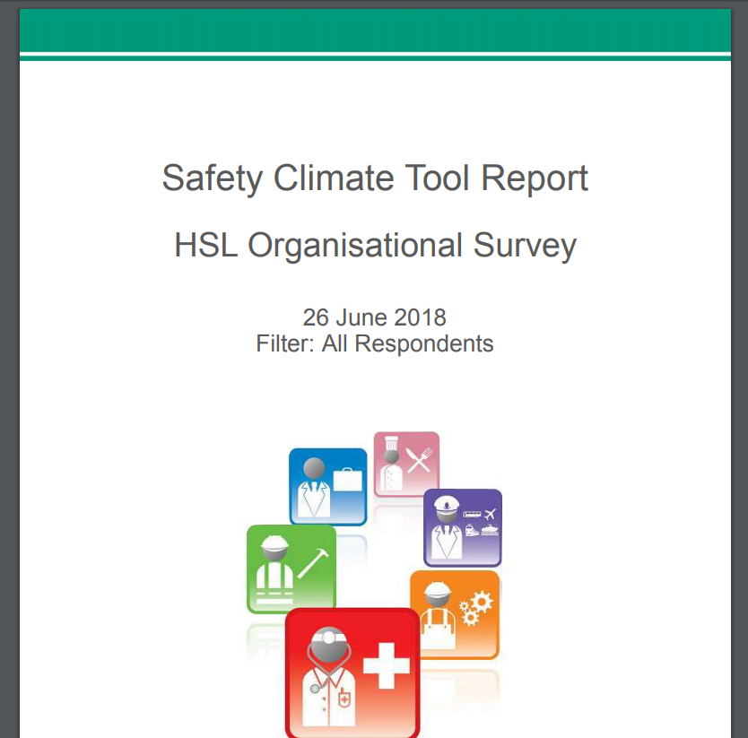
What happens to the information?
We will feed back the results by:
Example Ltd
Notes:
Presentation notes
The closing date for the survey is [date]. We’ll get a report and we’ll feed back the results through:
[Focus groups, meetings, intranet, staff briefings, unions]

Slide 7
ANY QUESTIONS?

