Slide 1
Taking health and safety to the next level
Making the case
Notes:
This presentation is designed to help you present some of the arguments for using HSL’s Safety Climate Tool within your organisation in order to obtain senior management buy in.
At the end of the presentation you will find some slides that explain what the Safety Climate Tool is, what it looks like as well as the five step approach to improving your safety culture so your organisation can make the most of the data.
You may decide to use some or all of the slides depending on the stage of your discussions with senior management.
If you still struggle to get senior management commitment you may find it helpful to arrange to have informal meetings with your directors or senior managers on an individual basis to find out more about how they view the importance of improving your safety culture, what are the real barriers in your way to getting the resources you need and establish some common ground.
Each slide has accompanying notes:
Guidance notes: These notes provide you with additional background to the slides and help you answer any questions that may come your way.
Presentation notes: These notes provide you with the content for your presentation that you can adapt to suit your personal style and the needs of your organisation.

Slide 2
Understanding our safety culture
Notes:
Guidance notes:
This slide illustrates that within any organisation there will always be working practices and behaviours that are not easily identifiable through conventional methods.
Presentation notes:
The culture of an organisation is often referred to as the ‘shared values and beliefs’ held by those in the organisation and as a sub-culture of an organisation, safety culture refers to the ‘shared values and beliefs’ held about health and safety. In other words, the way we do things around here. Safety climate is a moment in time, a snap shot of the perceptions held about the shared perceptions and meaning given to the policies, procedures and practices the workforce experience.
There has been a growing body of evidence that suggests that organisations who measure their safety climate and take action to resolve issues that arise have fewer accidents and near misses. Like the iceberg, safety climate can indicate where the weaknesses and gaps are in our health and safety management system that might not be observable through conventional audits and observations.

Slide 3
Multiple layers of defence/barriers
Notes:
Guidance notes:
This is adapted from James Reason’s Swiss Cheese Model to illustrate that what the Safety Climate Tool data will fill some of those gaps.
Presentation notes:
The Swiss cheese model of accident causation shows us that although we put up many layers to reduce the likelihood of accidents and hazards there will always be flaws in each layer and if these are aligned then that could allow an accident to occur.
The purpose of measuring our safety climate is to use that data in conjunction with other data we hold to understand where those gaps are and do something about them.

Slide 4
The case for change
Moral
Business
Legal
Notes:
Guidance notes:
Before any formal presentation to promote the benefits of taking action it may be useful to meet informally with each senior manager individually.
Most arguments for taking action to improve health and safety tend to revolve around three key areas: Moral, Legal and Business. These are not presented in any particular order.
If you are asked ‘Aren’t we doing this anyway?’ or ‘You are the health and safety professional, I thought it was your job?’
You should counter that organisations that engage their workforce so that health and safety becomes everyone’s responsibility have fewer accidents and higher levels of productivity. Your organisation has gone as far as it can but a different approach is required. You need their support as change of this kind does not happen over night.
Presentation notes:
There are three main reasons why it is important for us as an organisation to pay attention to the safety climate in our organisation.
We have a moral obligation to look after the people we employ
We have a legal responsibility to comply with health and safety law
We need to remain competitive and to that end our reputation is everything.

Slide 5
It is the right thing to do
Robert 57 was killed by a moving vehicle on site
Luke 25 died from a fall from height
Mark 38 was killed by machinery
Notes:
Guidance notes:
HSE publishes up to date information about prosecutions for each region at Press.hse.gov.uk/regional/ and the above examples are taken from the Health and Safety statistics 2017/18
Presentation notes:
HSE’s website lists the accidents and fatalities that occur every month. Each month there is at least one person who has been killed at work.
According to HSE statistics 144 workers were killed at work
555,000 injuries occurred at work according to the Labour Force Survey
71,062 injuries were reported under RIDDOR
None of us would wish any harm to come to the people that work here but its not that simple. We have a moral obligation to look after the people we employ. Who wants to be the one to inform the family?
These accidents might not have happened if the safety culture of those organisations were stronger.
There are other listings on the HSE website that also include members of the public. A power company failed to act when they received notification from the public that one of their power lines had come down. They could have switched off the power to that part of the line but they didn’t. They sent a technician out but it was too late for the jogger who ran into the wire and was electrocuted. His death was witnessed by passers-by who had to be treated for post traumatic shock.

Slide 6
How an accident affects you, me and us
How would we cope if our employees saw one of their colleagues get badly hurt or worse?
How would we feel getting in touch with the relatives or next of kin?
How would we feel having to deal with the Police and HSE?
What would it feel like for our reception staff having to field press enquiries?
Notes:
Guidance notes:
No one likes to think that they would be detached or unemotional if something bad happened to one of their employees so this section does need to be handled fairly carefully. The best way of approaching it is to have an open discussion. Perhaps take an example of one of your near misses where it could have been much worse so that the senior managers can relate more closely to your anecdote.
Try to avoid the conversation at this stage moving towards the legal and financial impact this might have. This is about exploring feelings. If you are challenged then move onto the next slide as this does provide an example of a Corporate Manslaughter case and that might drive the message home more clearly.
Presentation notes:
I want to give you an example of a near miss that happened here…
Luckily for the employee(s) involved it did not result in them getting hurt or killed but what about next time
[Go through the questions on the slide one by one. Do not be afraid to leave a silence at the end of the question. Someone always fills the gap. It doesn’t have to be you]

Slide 7
Legal cost
Duty holders found guilty of health and safety offences in 2017/18 received fines totalling £72.6 million.
The average penalty per case resulting in conviction is £147,000.
In 2017/2018 the single largest fine was £3million and 45 cases were fined over £500,000.
Notes:
Guidance notes: The Corporate manslaughter and Corporate Homicide Act 2007 is one that senior managers may not be aware of, especially that they could face prison time. However, companies and organisations that take their obligations under health and safety law seriously are not likely to be in breach of the new provisions. Nonetheless, companies and organisations should keep their health and safety management systems under review, in particular, the way in which their activities are managed or organised by senior management.
In conjunction with the Institute of Directors, HSE has published guidance for Directors on the responsibilities for health and safety within
‘Leading health and safety at work: leadership actions for directors and board members’ (INDG417)
Presentation notes:
Think what the impact of a £147K fine would have on our business in terms of our reputation with our customers, suppliers etc.

Slide 8
Business
Cost to the individual
Cost to our business
Cost to the individual – incalculable
Loss of income
Pain from injury
Reduced quality of life
Worry and stress
Visible cost – insurance
Hidden costs
Product, plant, equipment damage
Production delays
Overtime working, hiring new /temporary labour and training
Loss of expertise and experience
Investigation time
Fines
Reputational damage
Notes:
Guidance notes: There are a number of hidden costs that eat into an organisation’s bottom line. Depending on which industry you are in there may have been some high profile cases you are aware of where the reputation of the company involved has been tarnished in some way. Loss of reputation should not be underestimated.
Presentation notes:
The cost of doing nothing could prove more expensive than the cost of running a survey and asking the workforce how can we get better at what we are doing.

Slide 9
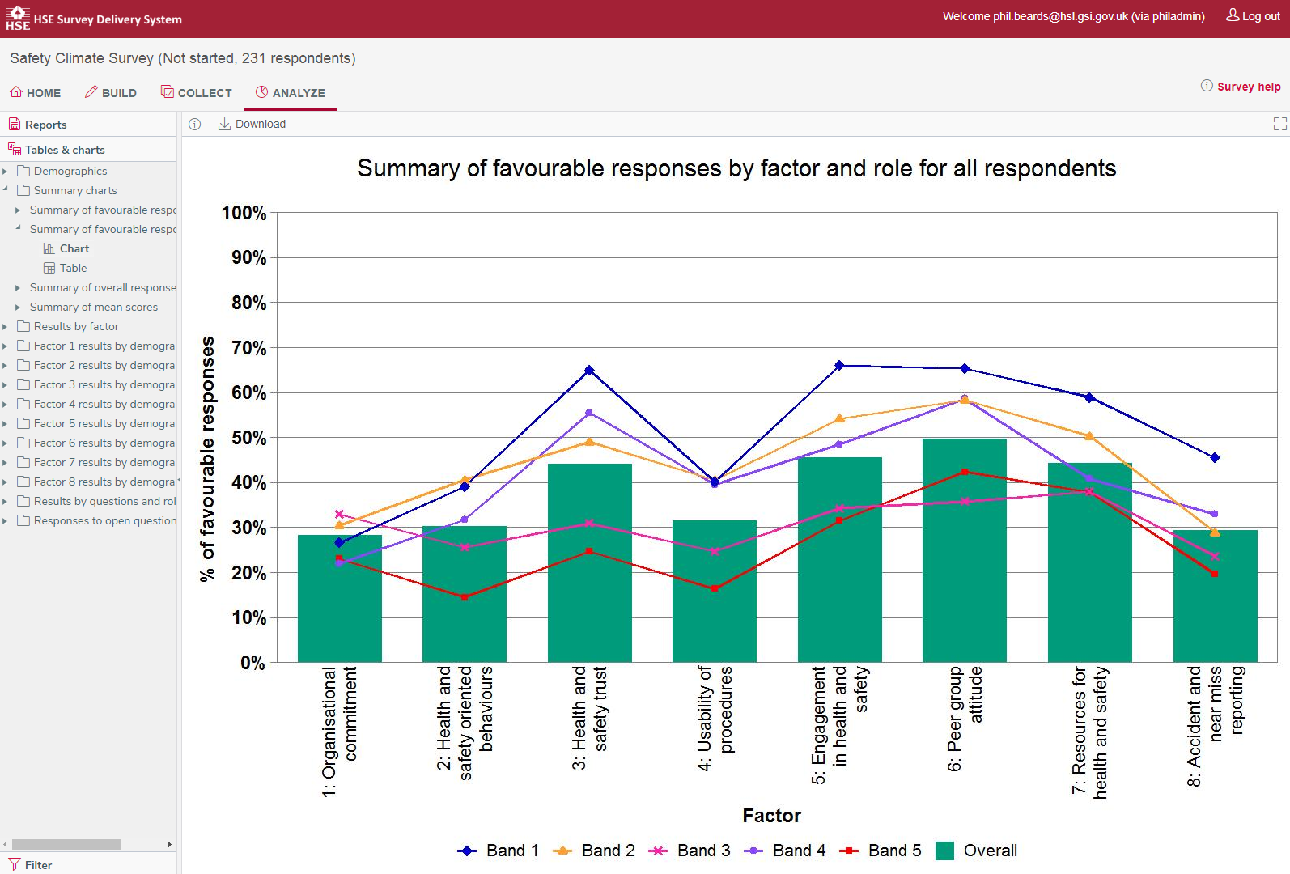
Is our thinking out of step with our workforce?
Notes:
Guidance notes:
The way we make decisions can be biased towards what we already know or think we know. The way we process information steers us to look for associations and patterns even when the objective evidence may be telling us something different. When we engage with more people we are not delegating power and responsibility, merely checking that their understanding of what we require is what we have asked for. It means there is less room for misunderstandings.
Presentation notes:
This is an example taken from one of the graphs available to us with the SCT. The blue line at the top is how senior management feel about health and safety across the eight factors the Safety Climate Tool measures. From what HSL tell me, it is not usual to have a different view of how things are compared to the rest of the workforce and it is likely we will see the same differences here. What we need to aim to do is close the gap and at the moment we do not have anything that will give our business the insights this tool will give us.

Slide 10
How we improve our safety culture
Stages to Assess and Improve Safety Culture
Notes:
Guidance notes:
This slide contains the stages to assess and improve safety culture using the Safety Climate Tool. You will need to get senior management buy-in to this process because not only will they have to lend their name to any communications that go out about it, they also have to be more visible on site. They need to be warned that the results may not make for easy reading but if they ignore them it will not help.
The five stages will enable you to properly plan your survey and ensure that you get data from it that will help you plan at both a strategic and tactical level.
Presentation notes:
I need your agreement to use the Safety Climate Tool. Developed by the Health and Safety Executive and purchased by way of a one-off five year licence it will allow us to survey our workforce, identify where potential gaps are in our health and safety management systems and provide through an auto-report some high level suggestions for moving forward. It also comes with benchmarking data so we can see how we compare with other users of the Safety Climate Tool.
The Health and Safety Laboratory (HSE’s Science Directorate) suggest a five stage approach to running the survey. They advocate this approach to get the workforce thinking about what health and safety means for them. It’s importance will be demonstrated at the early stages. I plan to set up a steering group that will consist not only of our union/safety reps but others who show an interest in health and safety. We will also invite members of the workforce to represent their part of the business to act as champions. This cannot be done without your ongoing commitment and support and I would ask that one or more of you join the steering group.
The next slide illustrates what I propose should happen.
They advocate this approach because the ultimate aim is to improve the safety culture of the organisation and begin to change safety behaviours. This is encouraged through engaging the workforce not only in completing the survey, but also in the run up and most importantly by providing feedback on the results in a timely way and acting swiftly to address some of the initial findings.
:
Foundation: We will need to think about what we want to achieve and it will involve laying down the foundations for the survey. I will need you to be visibly committed to the survey and responding to the results. I would like someone from the senior management team to sit on a steering group I am hoping to set up so we have some oversight.

Slide 11
ASECNT: A framework for safety culture improvement
Senior management commitment
Project plan
Intervention impact evaluation
Steering group
Communication strategy
Foundation
Evaluate
Leading & lagging indicators
Process evaluation
Analyse
Survey
Data analysis
SMART action plans
Focus groups
Act
Interventions
Focus
Workshops
Interviews
Notes:
Guidance Notes:
Foundation: We will organise a steering group, communicate to the unions/safety reps and set up champions for each site. We will have a communications strategy so we can reach as many people as possible.
Analyse: Once we have sat down and agreed how the survey will be delivered; on-line or on paper we can see what results we have coming through
Focus: Ideally we should feedback the results as soon as possible and HSL advocate focus groups to explore in more depth some of the survey findings.
Act: This is action planning and doing what we said we would do.
Evaluate: This is where we work out what worked and what worked less well so we are prepared for the next survey. We should also evaluate how well any intervention we put in place has been received.
Presentation Notes:
These are the activities I want us to consider doing here to make a real difference. This is not just about a survey. It is to really engage our people in health and safety so we can be more efficient, productive and we avoid losing experienced personnel.

Slide 12
Safety Climate Tool
What it is and what it does
Notes:
Guidance Notes:
These slides are an additional resource that are not meant to be used as part of ‘Building the Case’ but you may find helpful from time to time to explain what it is you are doing during any future presentations when you talk about the results to your ‘Top Management’.

Slide 13
Safety Climate Tool Factors
Notes:
Guidance Notes:
HSL’s Safety Climate Tool survey measures responses against eight factors. These factors are based upon research into safety climate. They have been statistically validated to ensure that the Safety Climate is a robust instrument to capture the perceptions the workforce holds about the culture in their organisation. The factors explore a variety of issues including leadership, supervision, peer support, working practices and procedures, resources, and the priority the organisation places on health and safety .

Slide 14
Reported benefits from measuring safety climate
Reduced accident rates
An international food manufacturer saw a sustained decline in accident rates, with averages per month reducing from 7.7 to 3.2 over a six year period.
Increased productivity
For the first time in their 108- year history, a global mining company saw none of its 200 full time employees or 100 contractors miss work due to a work-related injury.
Notes:
Guidance notes:
These are some examples that you can use to demonstrate how others have found using the Safety Climate Tool

Slide 15
Other benefits from using the SCT
Better communication across all staff levels
“The SCT was invaluable to us. Too much time is spent discussing both culture and leading indicators in vague and imprecise ways - prejudice not evidence.”
Olympic Delivery Authority, London 2012
Notes:
Guidance notes: The London 2012 is still the only Olympic Games in history where no fatalities occurred on site. The Safety Climate Tool was used throughout the Olympic Park and helped provide the context for their behaviour safety training.
Examples of good practice seen during HSL’s research on site included:
‘Top Management’ were visible on site and talked with employees to see how things were going on.
Project Managers were visible and held site meetings each morning to discuss movements on and off site, especially where there were a number of trades and different parts of the supply chain involved.
Workers were not afraid to challenge bad behaviour.
A zero tolerance for graffitti and anti-social behaviours in the changing rooms and toilet areas was reinforced. As a result the welfare areas were kept clean and tidy, people respected others property and there was little or no petty thieving.
Managers always listened and even when they could not provide an immediate answer, they always acknowledged the query.
A forklift driver was warned not to work near the canals without a banksman to avoid tipping over. After doing so he was removed from site and everyone including the Union agreed it was the best thing to do because ‘he was not working safely.’
A supervisor stopped a labourer demolishing a partition wall with a sledge hammer and showed him how it could be cut into panels so the job was cleaner and the panels could be removed more easily off site. The labourer thought it was a great idea because he had less bending down and carrying to do. The labourer said he had done other jobs since and used the same technique and his bosses were happy because it made them look efficient.
A builder who had been in the trade for over thirty years was thrilled to receive recognition for a suggestion he made in the form of a breakfast voucher. He said that no one had asked his opinion before or given him any form of recognition.

Slide 16
Testimonials
Ford Motor Company Ltd
"We have a very good safety record in Ford, however it's easy to get complacent. This survey allowed us to get a level of insight and understanding not previously available. In particular we started to get to know how our people 'feel' about our commitment to safety and build a response that will further improve our safety record. Be prepared for honest and sometimes difficult messages, but it's worth the journey!"
Rob Ardley, Human Resources Manager,
Ford Southampton
Notes:
Guidance Notes: Further case studies and testimonials can be found at www.hsl.gov.uk/products/

Slide 17
Testimonials
Nestle PTC “Obviously our aim is for Nestle PTC York to maintain its excellent safety record. We have chosen HSL as a strategic partner to help us in maintaining and enhancing our safety culture. Understanding the current safety culture is another step along our Safety Roadmap and HSL’s Safety Climate Tool will allow us to involve our people in maintaining and achieving world class health and safety excellence”
Kev Smith, Safety Manager at Nestle PTC
Burton’s Foods
“HSL’s Safety Climate Tool has provided us with useful data that allows us to understand our current safety climate and identify the areas of our business that we should target in order to make long-term, sustainable improvements. This data also provides us with an important baseline by which we can measure the effectiveness of our improvement projects, not only on our safety culture, but also on our accident rates”
Dan Bowles, Health and Safety Manager, Burton’s Foods

Slide 18
Open questions
Notes:
Guidance Notes: In addition to the 40 items in the Safety Climate Tool survey you are able to ask up to six open questions. You are strongly advised not to use all of them. Remember at the initial stages you are trying to demonstrate that the organisation is taking a new approach and in the long run if you not feedback and act on the information you receive it will make it harder for you to win your workforce over.
Two questions that would be useful to ask as part of your first survey are:
If you could make three changes to the way health and safety is managed where you work, what would they be?
What the positive things you see at [organisation’s name] about health and safety?
Each year you should check how the workforce has responded to any interventions you put in place…e.g. ‘As a result of your feedback during the previous SCT survey we gave you a choice of the type of gloves you could order. Is this working?’

Slide 19
Taking the temperature
Notes:
Guidance Notes: The automatic report includes benchmarking against each of the eight factors as standard. Additional sector specific benchmarking is available to allow you to benchmark your performance directly with others in your industry. Further details can be found at www.hsl.gov.uk/products

Slide 20
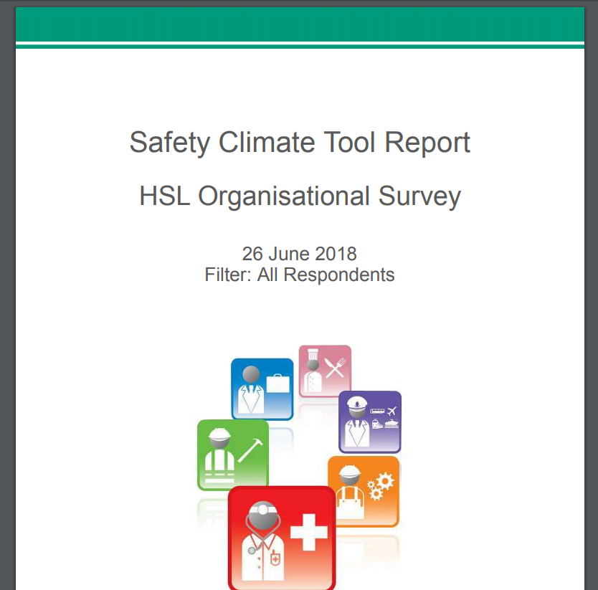
Example SCT Auto Report
Notes:
Guidance Notes: Once you have closed your survey, at a click of a button you can download an auto report. Depending on your choice of demographics, using the filters allows you to create any number of reports. For instance you may want to know how your 18-24 year olds respond as this group are typically more likely to take risks. At the other end of the spectrum you may wish to create a report that explores the perceptions of those with the longest tenure.
To discuss safety culture and how it applies to you, please contact:
Phoebe Smith +44 (0)203 028 2157 phoebe.smith@hse.gov.uk
Jane Hopkinson +44 (0)203 028 2008 jane.hopkinson@hse.gov.uk

